Slide 1

New Member Orientation
Prepared and Updated Once in a While by PDG Ken Echeberry
Updated October 2015

Slide 2
A Typical Lions Club
Organized, and received Charter
  Sponsoring Club
  Guiding Lion appointed by District Governor
May be Sponsor of another club
Generally Operate under Standard Form Lions Club Constitution and By-Laws
  May have established own Constitution and By-Laws
May Have Incorporated as a Nonprofit Corporation
May have established a Charitable Foundation

Slide 3

Club Officers and Directors
President
Immediate Past President
Secretary
Treasurer
1st Vice President
2nd Vice President
3rd Vice President
Lion Tamer
Tail Twister
2 Directors (First Year)
2 Directors (Second Year)
Membership Director
Notes:
Some clubs include the Bulletin Editor as a board member to help ensure they get all of the information they need to put out a quality bulletin.

Slide 4
Terms of Office
Club Officers and Directors serve for One Year
Elections are held each year with nominations made in April and election held in May
President appoints all committee chairmen
Notes:
Results of the elections are reported to International via the PU-101 form (personnel update). It must also be reported to Multiple District 4 office via separate correspondence.
International updates their records and beginning sending club correspondence to the appropriate person.
The current President, Secretary and Treasurer are the only ones who may order supplies from International and have them billed to the club account.
Multiple District 4 needs the new officer information for the same reasons.

Slide 5

Club Dues
Your Annual Club dues, and maybe billed on a semiannual or annual basis .
  Club dues must include amounts necessary to cover Membership Dues to International, Multiple District 4, and District 4-L1.
    Annual Dues 2015
    International $43.00
    MD-4 $14.00
    4-L1 $15.00
    Total $72.00
  May include cost of meals
  Determined by Club membership
  Determine Operating Budget for the Club
The 6 month periods are defined as July 1st through December 31st and January 1st through June 30th.
International sends out semi-annual dues assessment in January and July
MD-4 sends out semi-annual dues assessment for MD-4 and 4-L1 in February and August
Notes:
Dues vary by Club. In some countries dues are very high and becomes one of the clubs principle ways of raising charity funds.
When the cost of meals is included in the dues structure – the Lions pays for the meal whether or not they attend or partake of the meal.

Slide 6
How Your Club Spends It’s Money
Club operating expenses – Remaining Dues
  News Letter, Guest Meals, Insurance, Club Awards, and other expenses as directed by board of directors.
  Dues are supplemented by – Tail Twister, Raffles, Other Club Functions
Two types of accounts –
  Administrative (Operation $ from Club members),
  Charity (Activity $ raised from community)
All Funds raised from the community must go into the Charity (Activity) account. They can not be used supplement operating expenses of the club.
Notes:
The club board of directors may authorize a stipend for members attending conventions, forums, or other meetings outside of the club.
Any fund raising activity that the public would perceive as being done by the Lions must have the proceeds go into the clubs charity account.
The club must maintain their operating and charity accounts as separate accounts and funds can not be commingled.
Operating account funds can be used for charity, but charity funds can not be used to support operation of the club.

Slide 7
Club Principal Activities
Charity Fundraising Activities (Examples)
  Flag Program, Food Booth @ Fairs, Fourth of July, Bingo, Watermelon Festival, Fish Fry Mule Days etc.
  Request for donations
  Other events as approved by board of directors
Charitable Activities (Examples)
  Eye glasses and exams, Youth Activities
  Lions supported foundations – LCIF, Lions Sight & Hearing Foundation, Lions Camp at Teresita Pines, City of Hope
  Local charities or organizations
  Other activities as approved by board of directors

Slide 8
Lionism and Lions Clubs
Lions Clubs are the building blocks of Lionism.
As every Lions Club is part of a larger structure:
Lions District 4-L1 is one of 15 California Districts that make up Multiple District Four (MD-4).
Notes:
5 to 8 Lions Clubs (or more) are generally grouped together to form a Zone with a Zone Chairman assigned by the District Governor to assist the clubs in the zone.
Zones are generally grouped together to form a Region (two or more zones) under the stewardship of a Region Chairman appointed by the District Governor.
Regions are grouped together to form a District which is lead by an elected District Governor. Our District has it own constitution and by-laws which govern the operation of the district. A District generally has 35 or more clubs and at least 1250 members.
Districts are grouped into Multiple Districts. Our District 4-L1 is one of the 15 districts that comprises (make up) Multiple District 4 (MD-4). MD-4 has its own constitution and by-laws and is governed by the council of governors.

Slide 9
District 4-L1
Comprised of almost five counties
  All of Mono and Inyo Counties
  Portions of Los Angeles
  Portions of San Bernardino
  The City of Tehachapi and that portion of Kern County lying east of the Tehachapi Mountains
There are 34 Lions Clubs in District 4-L1 with membership of approximately 875 Lions
In addition, some Lions Clubs sponsor Leo Clubs. Your club may want to do the same thing.

Slide 10
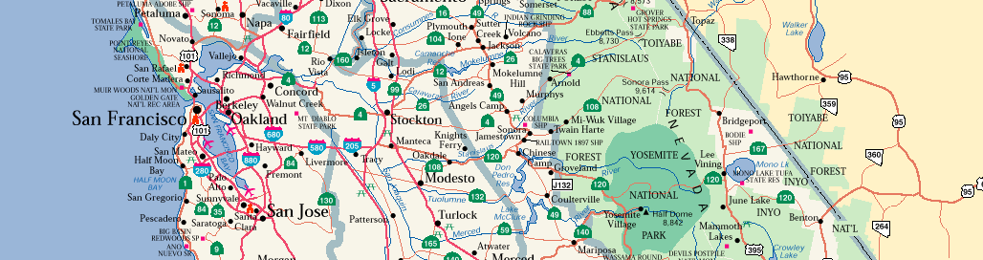
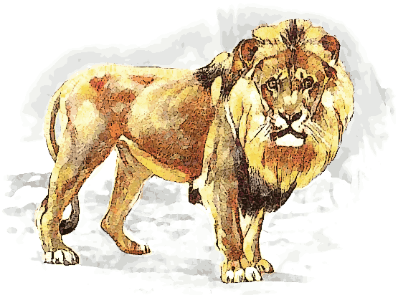
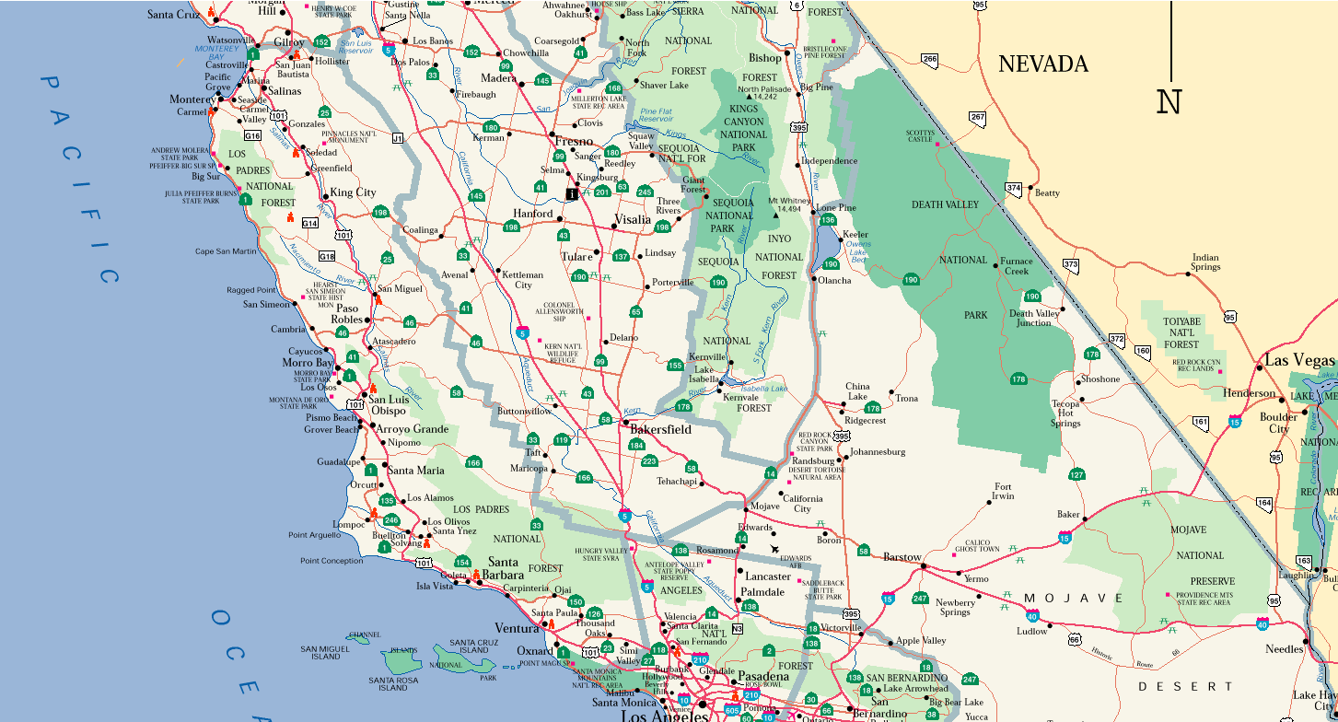



Slide 11
Cabinet Officers
District Governor (DG)
1st Vice District Governor (1stVDG
2nd Vice District Governor (2ndVDG)
Cabinet Secretary
Cabinet Treasurer
Immediate PDG (IPDG)
Region Chairs, and Zone Chairs
Chairman Global Leadership Team
Chairman Global Membership Team
The District publishes a District Directory each year and the current years Cabinet Officers are listed in the Directory. The Directory is generally available by August of each year.
Notes:
The qualification requirements, duties and term of office of the District Governor and Vice District Governors are define by the Constitution and By-laws of the International Association of Lions Clubs.
Nominations for District Governor and Vice District Governors are made to the Nominating Committee by his or her club upon approval of the majority of club members. Nominations must be receive by the conclusion of the third Cabinet Meeting.

Slide 12
Terms of Office
Cabinet Officers serve one-year terms
District Governor and Vice District Governors are elected Positions
  Elections are held each year at the annual District Convention (generally held in May)
District Governor appoints all others
  May separately appoint a Cabinet Secretary and a Cabinet Treasurer or appoint one individual to serve both offices.
  May choose not to utilize the position of Region Chair
  Must appoint Zone Chairmen

Slide 13


District 4-L1 - Regions
Metro
  Region Chair – Esau Tenorio - L A Los Feliz
    Zone “A” Chair – Carol Mares - L A Host
      LA Host, LA International, LA Little Tokyo, LA Envision, LA Golden
    Zone “B” Chair – Ginny Hsiao - LA American Global Chinese
      LA American Global Chinese, LA Chinatown, LA Chinese, LA Latin American, Griffith Park
    Zone “C” Chair – Glenn Kawahara - L A Los Feliz
      Eagle Rock, LA Los Feliz, Northwest Glendale, Hollywood Entertainment, Wilshire
Valley
  Region Chair – Aurelia Weinstein - West Valley Alliance
    Zone “A” Chair – Owen Kato - L A Mid-Valley
      Castaic, Greater West Valley, LA Mid Valley, North Hollywood, Toluca Lake
    Zone “B” Chair - Dionisio Marquez- West Valley Alliance
      Burbank Noon, Crescenta-Cañada, Northridge, Sunland-Tujunga, West Valley Alliance

Slide 14

District 4-L1 – Regions (cont.)
Desert
  Region Chair – Scott Wedding - Acton
    Zone “A” Chair - Terry Cornell - Palmdale
      Acton, Mojave, Palmdale
    Zone “B” Chair – Susan Morrison -Tehachapi
      Boron, California City Host, Ridgecrest, Tehachapi
Sierra
  Region Chair – Ken Lloyd - Bishop
    Zone “A” Chair – Jeffrey Mullenhour - Bishop
      Bishop, Independence, Lone Pine, Mammoth Lakes

Slide 15

District 4-L1 Finances
Administrative Expenses met via per capita tax of $15.00 per year
  Paid semi-annually by club to the District through the Multiple District (MD-4)
    $7.50 Payable October 1st, based on June 30th membership
    $7.50 Payable March 1st, based on December 31st membership of previous year
  $4.35 of the annual per capita tax is transferred to the Convention Fund (29% of the monies received from MD-4). This fund is managed by Convention Committee and accounted for separately. Fund is used to supplement annual convention expenses.
  Raffles, and other designated fund raising activities

Slide 16
Conventions
District 4-L1 Convention usually held 2nd or 3rd full weekend of the month of May.
The location of the following years District 4-L1 Convention is voted on at the Convention
Each club entitled to one (1) voting delegate and one (1) alternate for each ten (10) club members, or major fraction thereof.
List of accredited delegates must be submitted to Credentials Committee prior to opening business session
Voting delegates are not certified unless Club is in good financial standing with MD-4/4-L1
Notes:
At the District Level our Constitution and By-laws provides that All International Officers including the current Governor and all Past District Governors residing in or belonging to a club in this district in good standing shall have a vote at all conventions of this District.
This vote is independent of the delegate quotas allowed the club.

Slide 17
District Club Contests
Each club is eligible and encouraged to compete in the following District contest:
  Governor’s #1 Club
  Interclub Activity Visitation
  Club Bulletin
  Club Scrapbook
Rules for each contest are defined in the District Directory and maybe altered each year by the new District Governor

Slide 18

Individual District Awards
Each Lion in the district is encouraged to satisfy the requirements for the following awards:
  Long Tail
  Short Tail
  Proud Lion / Proud Sponsor
  100% Secretary
  President Excellence
Rules governing each award are explained in the District Directory

Slide 19









District Endorsed Projects
4th District Student Speakers Foundation
City of Hope
Lions Float Inc.
Lions Sight and Hearing Foundation of So. Cal
(formally LEFSC & SCLEI)

Slide 20
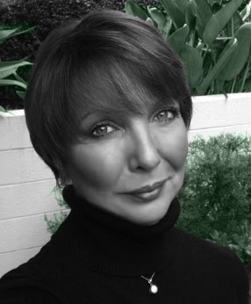
MD-4 Structure
Managed by a Council of Governors comprised of the 15 District Governors, chaired by a Council Chair and two Vice Chairs. Vice District Governors attend all Council meetings. Activities are conducted by some 16 standing committees.
Permanent office is located at 129 Los Aguajes Ave., Santa Barbara, California with a two-person staff.
  Tiana Gia Cara, MD-4 Office Manager
  Phone # 805-963-6681, or 1-800-546-6634 ; Fax: 805-963-8254
  Email: admin@md4office.org
  Website: http://md4lions.org/
Four Council meetings held each year generally in August, November, February and June at locations selected by the Council.
The MD-4 Annual Convention is held each year in February. The next 2 Conventions are scheduled for:
  February 5 - 7, 2016 .......................................(Doubletree) Modesto, CA; 4-A1
  February 10-12, 2017 ........................................(Red Lion) Redding, CA; 4-C1
Notes:
Multiple District 4 staff send out dues billings to each club. They collect the dues for the District and Multiple District and then distribute collected dues to the individual districts.
They also maintain records for the Multiple District, distribute Student Speaker Information and generally serve the membership of the Multiple District.
When the position of 1st and 2nd Vice District Governors were created they were added to the meetings to improve their exposure to how business is conducted at the Multiple District level.

Slide 21
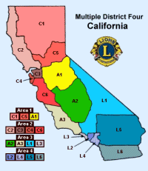

Slide 22
LCI Headquarters
Administers the Headquarters and Staff
LCI Headquarters
Lions Clubs International Organization Chart
BOARD OF DIRECTORS
Directs association in meeting its purposes by establishing general policies to guide its operation
EXECUTIVE COMMITTEE
Acts for the board of directors when members are not in one place or in session
PRESIDENT
Executes policies and administers operation of association in a manner which will further the purposes of Lions Clubs International
LCI Headquarters
Administers the Headquarters and Staff
District Governor*
1st Vice District Governor
2nd Vice District Governor
Cabinet
Secretary-Treasurer
Region Chairpersons (Optional)
Zone Chairperson
Zone Chairperson
Advisory Committee
Lions Clubs
Lions Clubs
Lions Clubs
Delegates Delegates Delegates
THE ANNUAL CONVENTION

Slide 23
International Structure
7 constitutional areas defined as:
  1. United States of America, its affiliates, Bermuda and The Bahamas
  2. Canada
  3. South America, Central America, Mexico and The Islands of the Caribbean Sea
  4. Europe
  5. Orient and Southeast Asia
  6. India, South Asia, Africa and The Middle East
  7. Australia, New Zealand, Papua New Guinea, Indonesia and Islands of the South Pacific Ocean.
It is managed by a 38 member Board of Directors.
  Specific duties are assigned to the International President and two Vice Presidents. Elect 2nd VP who advances through positions
  Immediate Past International President.
  34 Directors, Elected to a Two (2) year term. Half elected new each year
  A Multiple District may have only one person at a time serving as a member of the International Boar of Directors.
International activities are conducted by numerous standing and special committees whose members are appointed by the International Board.
Permanent offices are located in Oak Brook, Illinois, with a large capable full-time staff.
Notes:
The international organization has its own constitution and by-laws and as an International Organization we are governed by a 37 member board of directors.

Slide 24
International Meetings
The Annual Convention of Lions Clubs International is usually held in early July of each year. The next four International Conventions will be held:
  June 24 - 28, 2016 Fukuoka, Japan
  June 30-July 4, 2017 (Centennial). Chicago, Illinois, USA
  June 29-July 3, 2018 Las Vegas, Nevada, USA
  July 5-9, 2019 Milan, Italy
USA/Canada Leadership Forums are held in September of each year. The next three USA/Canada Forums will be held:
  September 15-17, 2016 in Omaha, Nebraska
  September 21-23, 2017 in Portland Oregon
  September 20-22, 2018 in Columbus, Ohio
These forums were created to help clubs in the US and Canada retain and attract new members, and are loaded with good information and offer great opportunities to network with other clubs.
Notes:
New members to the board of directors are elected at the International Convention each year.
In order to improved the quality of Leadership throughout the USA and Canada a Leadership Forum was established and is held in September of each year. Other constitutional areas have similar leadership forums.

